Slide 1
Used Car Price Prediction
By Deepak Kumar

Slide 2
Contents
Business Goal
Exploratory Data Analysis
Data Pre-Processing
Observations
Conclusion

Slide 3
Business Goal
With the change in market due to covid 19 impact, few client is facing problems with their previous car price valuation machine learning models.
The goal of this project is to create a regression model that are able to accurately estimate the price of the house given the features

Slide 4
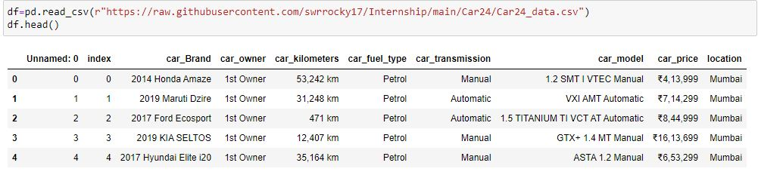
Dataset

Slide 5
Exploratory Data Analysis
Data contains 5342 entries each having 10 variables gathered from cars24.com site for multiple locations.
Data contains Null values. We treated them using the domain knowledge and your own understanding.
Extensive EDA has to be performed to gain relationships of important variable and price.
Data contains numerical as well as categorical variable.
Data is cleaned down further to have 4992 entries and 7 variables.
Independent Variable is car_price.

Slide 6
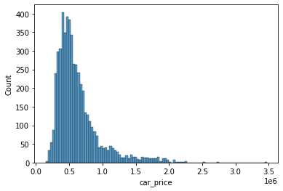
Distribution of Car Price It has few outliers and is rightly skewed

Slide 7
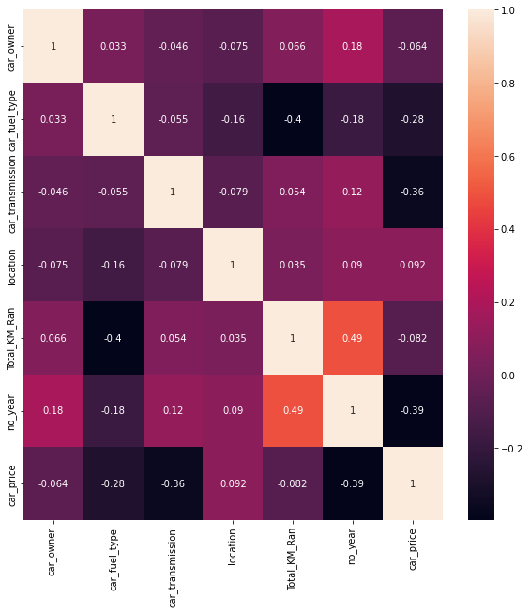
Correlations

Slide 8
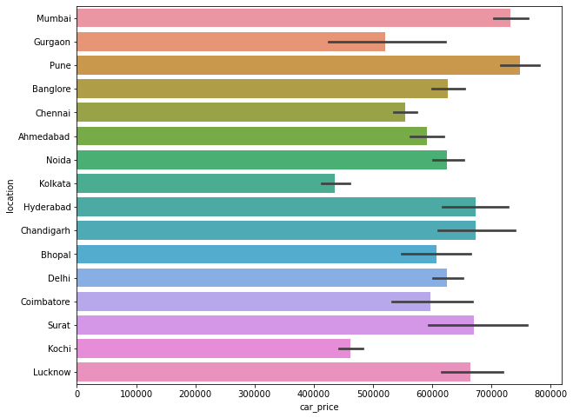
Relation between Location and CarPrice

Slide 9
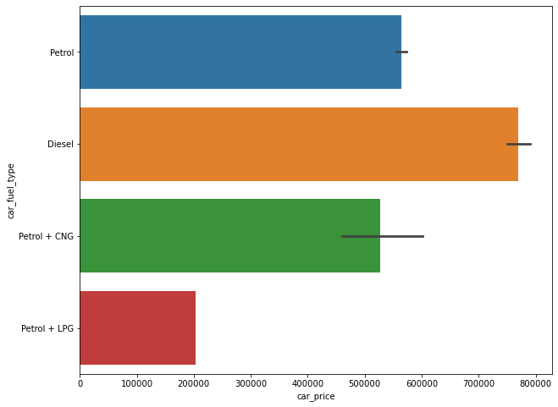
Relation between Fuel and CarPrice

Slide 10
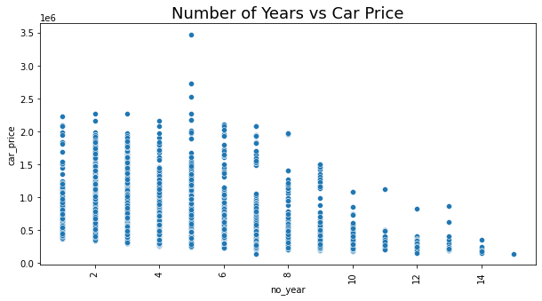
Relation between No Of Years and CarPrice

Slide 11
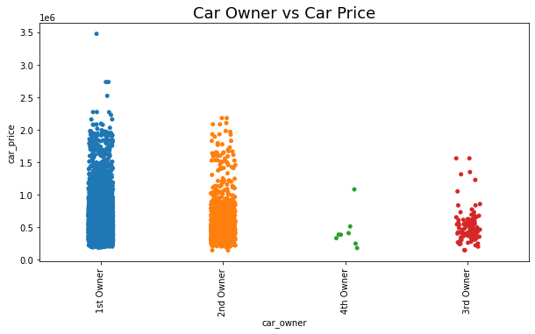
Relation between Car Owner and CarPrice

Slide 12
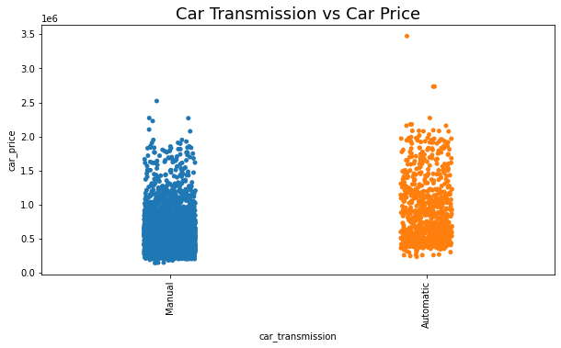
Relation between Car Transmission and CarPrice

Slide 13
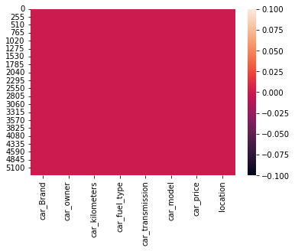
Missing Values

Slide 14
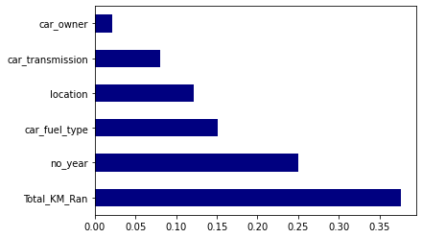
Tope Six Features

Slide 15
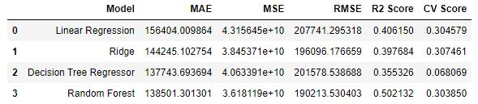
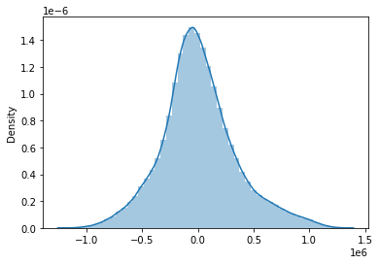
Model Data and Prediction Curve

Slide 16
Observations
In this study, our models we collected data for different locations from cars24 website
First, our study has shown that advanced machine learning algorithm RF is a promising tool for researchers to use in used price predictions. However, we must be cautious that these machine learning tools also have their own limitations. There are often many potential features for researchers to choose and include in the models so that a very careful feature selection is essential.
Second, many conventional estimation methods produce reasonably good estimates of the coefficients that unveil the relationship between output variable and predictor variables Based on these estimates, investigators can interpret the results and make policy recommendations.
The choice of algorithm depends on consideration of a number of factors such as the size of the data set, computing power of the equipment, and the availability of waiting time for the results.
The price evaluation model based on big data analysis is proposed, which takes advantage of widely circulated vehicle data and a large number of vehicle transaction data to analyze the price data for each type of vehicles by using the optimized BP neural network algorithm. It aims to establish a second-hand car price evaluation model to get the price that best matches the car.

Slide 17
Conclusion
The application of machine learning in used car price prediction is still at an early stage.
We hope this study has moved a small step ahead in providing some methodological and empirical contributions to property appraisal, and presenting an alternative approach to the valuation of used car prices.
For the other model, the error prediction values are still large. Using different methods that match the time-series data will be used in the future research to obtain smaller error prediction values and using more data to get the better result.
The increased prices of new cars and the financial incapability of the customers to buy them, Used Car sales are on a global increase. Therefore, there is an urgent need for a Used Car Price Prediction system which effectively determines the worthiness of the car using a variety of features. The proposed system will help to determine the accurate price of used car price prediction

Slide 18


